Slide 1
Presenter Name
Honeywell mobility edge
Date
Unified and Dynamic Platform for Your Mobile Workforce
Notes:
Talking Points
Today, we’d like to talk about a new approach to developing, deploying and mobile solutions from Honeywell we call Mobility EDGE.
Mobility EDGE is not a single feature or simple advancement in technology; it’s a complete solution, approach and platform – because you can’t afford to manage mobility one device, development or deployment at a time.

Slide 2
Presenter Name
Honeywell mobility edge
Date
A Unified and Dynamic Platform for Your Mobile Workforce
Notes:
Talking Points
Today, we’d like to talk about a new approach to developing, deploying and mobile solutions from Honeywell we call Mobility EDGE.
Mobility EDGE is not a single feature or simple advancement in technology; it’s a complete solution, approach and platform – because you can’t afford to manage mobility one device, development or deployment at a time.

Slide 3
Presenter Name
Honeywell mobility edge
Date
Unified and Dynamic Platform for Your Mobile Workforce
Notes:
Talking Points
Today, we’d like to talk about a new approach to developing, deploying and mobile solutions from Honeywell we call Mobility EDGE.
Mobility EDGE is not a single feature or simple advancement in technology; it’s a complete solution, approach and platform – because you can’t afford to manage mobility one device, development or deployment at a time.

Slide 4
Presenter Name
Honeywell mobility edge
Date
Unified and Dynamic Platform for Your Mobile Workforce
Notes:
Talking Points
Today, we’d like to talk about a new approach to developing, deploying and mobile solutions from Honeywell we call Mobility EDGE.
Mobility EDGE is not a single feature or simple advancement in technology; it’s a complete solution, approach and platform – because you can’t afford to manage mobility one device, development or deployment at a time.

Slide 5
CONTENTS
The challenges of mobilizing your global workforce
Why many mobile solutions fall short
Introducing Honeywell’s common, unified mobility platform
How we re-thought the core
Support for every stage in your mobility solution
How we ensure business continuity for you
Next Steps
ACCELERATE
DeploymentS
Mobility Edge™
OPTIMIZE
Performance
EXTEND Lifecycle

Slide 6
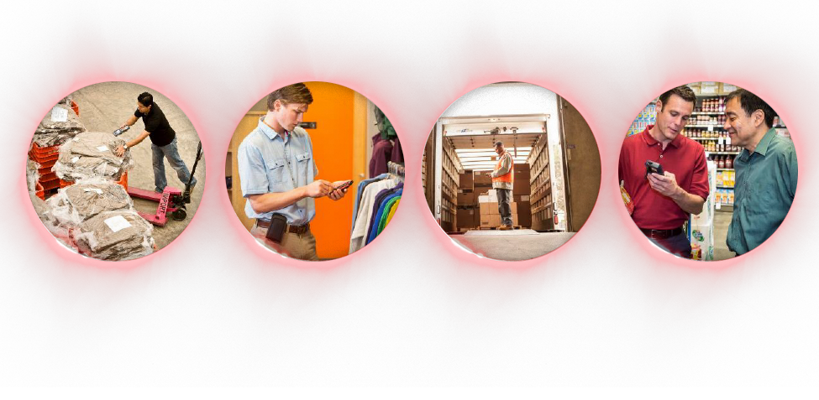
The challenges of mobilizing your global workforce
MOBILE ADOPTION SPEEDING UP
Heightened requirements to meet differing user preferences, application environments and form factor needs to support dynamic collaboration
SKILLED LABOR SHORTAGES
High turnover and reliance on seasonal workers heightens need for solutions with quicker user adoption and ramp up time
FRAGMENTED TECHNOLOGIES
Juggling multiple devices and operating systems across the enterprise introduces complexities for Enterprise IT to manage and maintain
SECURITY REQUIREMENTS
Enterprise IT needs effective methods to protect against mobile O/S and application vulnerabilities
Notes:
There are a number of elements that create barriers to an organization’s responsiveness to changes in the market.
The pace of mobile adoption is accelerating→ which is increasing range of use cases and requirements
Personnel and functions that all require some form of data-capture, scan and visibility
Differing user preferences, application environments and form factors – touch vs. keypad; rugged vs. semi-rugged; field based vs. on premises, etc.
Skilled labor shortages, high turnover, and increasing use of temporary workers
- Driving the need for simple, intuitive interfaces to speed adoption and ramp up time
Fragmented and inflexible technologies are time and labor intensive for enterprise IT to manage and maintain.
Laborious and costly testing, certification and deployment of applications across multiple form factors
Need to manage the unprecedented OS migration underway with the transition to Android – while accommodating current needs and technology infrastructure
Tapping into data to foster predictive maintenance or optimize usage of AIDC assets
Need a rapid upgrade path to maintain enterprise-class data security; there are risks related to system security, compliance and the cost of future enterprise-wide upgrades
- The devices may all run Android, but not in the same way or with the same user experience – requiring more siloed developments, more certifications, more deployments and more training.
- This challenge is exacerbated by regular OS patches and updates, leading to the necessity to manage varying O/S versions across multiple devices.
- They aren’t built with the flexibility to meet changing needs – to run the latest enterprise Android, to upgrade further – shortening the lifecycle of your investment and threatening data security.
Fragmented and inflexible technologies are time and labor intensive for enterprise IT to manage and maintain.
- Need a rapid upgrade path to maintain enterprise-class data security; there are risks related to system security, compliance and the cost of future enterprise-wide upgrades

Slide 7
Today, many mobile solutions fall short
6
6
Your organization has a complex combination of mobile devices, apps and infrastructure that is slowing you down.
The deluge of devices and apps written for mobile solutions on different operating systems are time and cost intensive for Enterprise IT to manage and maintain
Mobile solutions built on separate technology platforms create silo-based provisioning and application support
Device fragmentation and disjointed user experiences increase user adoption time and efforts
Inflexible mobile platforms that prevent you from keeping pace with the rapid changes your markets and customers require

Slide 8
All of which puts strain on …
7
7
Delivering functional and secure end-user mobile enablement to optimize business performance
Rapid and easy app development, testing, provisioning and deployment management
Fast access to the latest O/S security patches or two years of extended support beyond Android for legacy O/S versions
Tools to optimize productivity and drive efficiency of mobile workers
Forward-compatibility and future-proof solutions that extend TCO
Getting maximum ROI
Increasing uptime of device and users
Accelerating mobile deployments
Honeywell Confidential - © 2017 by Honeywell International Inc. All rights reserved.

Slide 9
To accelerate the EDGE, Rethink the CORE
8
8
Honeywell’s Mobility Edge platform helps you
overcome complexity
to build, manage, and deploy mobile solutions
across your enterprise
better, faster, with less risk, and less cost.
ACCELERATE
DeploymentS
OPTIMIZE
Performance
EXTEND
Lifecycle
Honeywell Confidential - © 2017 by Honeywell International Inc. All rights reserved.
Notes:
At Honeywell, after talking to many of our customers – and carefully analyzing user experience data from a range of Honeywell technologies – we completely rethought the approach to the challenges of supporting a mobile workforce. We quickly realized that no new simple upgrade in technology was enough. You need something more comprehensive and dynamic.
Standardizing on the Android operating system was critical.
But we also knew that you need a unified platform for all form factors – one that allows for rapid deployments, robust performance and adaptability to changing needs.
That’s why we created MOBILITY EDGE, a unified platform for mobile computing designed to simplify deployments, strengthen performance and extend the lifecycle.
When you have such a dynamic platform at the core of your entire mobile infrastructure, the benefits are swift and almost limitless.

Slide 10
Mobility Edge: The power of a unified, dynamic platform
9
9
9
Accelerate Deployments
Optimize Performance
Extend Lifecycle
Validate once. Deploy everywhere. Faster, easier deployments and at lower cost.
Productivity-optimizing tools. Faster data capture and secure, enhanced worker communications.
Forward compatible. Future-proof. Reducing TCO and minimizing headaches.
Quality and Security Built-In
Notes:
Because MOBILITY EDGE is a unified, dynamic platform – here’s what’s possible:
You can simplify deployment – validating new apps and updates once, then deploying across all form factors – instead of a burdensome process for each different device
You can drive device performance – Optimize productivity and efficiency with powerful, embedded tools across the platform that enable faster data capture and secure, enhanced worker communications.
You can count on a longer lifecycle, with hardware carefully designed to support twice the operating system upgrades that competitors’ products can support.
Our aim is to unleash you from all the constraints you’ve experienced related to deployment, performance and lifecycle of mobile devices. Now, let’s take a closer look at how MOBILITY EDGE helps you in each of these areas …

Slide 11
Accelerate Deployments Validate once. Deploy everywhere. Faster, easier and at a lower cost.
Suite of solutions to streamline the configuration and provisioning of mobile devices
Scalable for small, medium, and large organizations
Can be used with or without an Enterprise Mobility Management (EMM) system
Flexible options to meet the needs of every enterprise
Enterprise Provisioner
Create and edit provisioning files (device manifest and startup instructions)
Output provisioning barcodes (easy deployment of provisioning data to devices)
Web server (built-in location from which to access manifest files)
Settings Editor
Easily modify your main settings to your unique user needs and business requirements
Staging Hub
Integrated Provisioner and Settings Editor functionality
Identify and manage mobile devices on network
Push provisioning manifest to connected devices
Uplink for connected operational data
Keypad Creator
Develop customized on-screen keypad designs to address specific use cases
Setup Wizard
Enhanced dialogs highlighting NFC and barcode-based setup options
Support for third-party EMM provisioning methods
Secure Provisioning
Restrictions on when configuration and provisioning of device may occur
Prevents unauthorized tampering with device settings or manifest via barcode scan
Notes:
Ready, Set, Go. A dynamic platform with a rapid provisioning suite to accelerate, simplify and minimize the cost of deployments across your enterprise.
Quick configuration, certification and deployment through robust SDK and MDM tools
Flexible barcode, NFC, and network provisioning options
Validate multiple form factors at once, knowing that app updates will work across the platform
Leverage setup tools as you need them – standalone or integrated with your mobile device management system.
Simplify application integration to scanners, printers and more.

Slide 12
Optimize Performance Productivity-optimizing tools. Faster data capture and secure, enhanced worker communications.
Suite of solutions to enhance the usability of mobile devices
Optimized and enhanced data capture methods
Licensed productivity applications
Data Capture
Scan wedge (enables scan data to be received by non-scan aware applications)
Voice wedge (enables voice data to be received by non-voice aware applications)
Bluetooth pairing (NFC and barcode reading to facilitate rapid peripheral pairing)
Scan Zone (on-screen dynamic, movable scan trigger)
Scan data editing (programmatic modification to scanned data prior to receipt by app)
Enterprise Client Pack
Honeywell Launcher (lockdown/kiosk mode limits access to approved apps)
Terminal Emulator (data capture and input to back-end legacy server processes)
Enterprise Browser (web browsing experience in a controlled environment)
Wireless Tether
User notification of Bluetooth-connected peripheral disconnection
Prevents lost peripherals; reduces time spent finding peripherals
Find My Device
Locate mobile computer via Bluetooth even if powered down
Zigbee support
Communicate with Zigbee-connected IoT devices (sensors, etc.)
Integration with Connected Freight initiative
Notes:
MOBILITY EDGE leverages 10+ years of service and support data to ensure quality and user-friendly design is built in.
The result is a dynamic platform to drive productivity to the edge of your operation, with powerful embedded tools for:
Faster data capture
Rapid setup of user preferences and access to key apps
Intelligent battery optimization
Put the apps each user needs most at their fingertips with Honeywell Launcher.
Easily expand input options to scan and voice via wedge utilities.
Enhance ergonomics for each user via a movable scan trigger.
Business applications including Enterprise Terminal Emulation, which provides a secure, reliable connection to your data collection system, and Enterprise Browser, which allows for standard web applications in a controlled environment – keeping the user focused on the right applications

Slide 13
Extend Lifecycle Forward compatible. Future-proof. Reducing TCO and minimizing headaches.
Battery Monitor
At-a-glance indication of battery health and runtime remaining
Battery Runtime Maximizer
Onboard tool to enable tuning of device settings and performance characteristics
Allows optimization of tradeoffs between performance and runtime adjusted for individual customer preferences
Battery Hot Swap
Enables exchange of battery pack without rebooting of system
Simple user procedure to prepare system for battery swap
Operational Intelligence
Active monitoring of internal functions with cloud-based analytics platform
Self Diagnostics
Onboard application to exercise multiple device subsystems
Supports customer troubleshooting, technical support, and service
Extended Availability
Operating system support through Android Q
3 years support for security updates after each OS release
2+ years extended support for security updates following last supported OS version
Futureproof Platform
New form factors leveraging common platform assures application compatibility and ease of deployment
Notes:
Continuous system monitoring enables proactive corrective action, reducing downtime and increasing productivity
Get the most uptime out of every device through the intelligent battery monitoring and management.
Forward compatibility through Android Q without replacing devices
A dynamic platform that ensures you maintain the highest levels of cyber security and application performance for your operation through a streamlined, enterprise-wide approach to patch releases.
We’re providing a simplified deployment experience, certification method, simplified provisioning of devices, and ability to add additional form factors over time without “starting over” in their deployment plan.

Slide 14
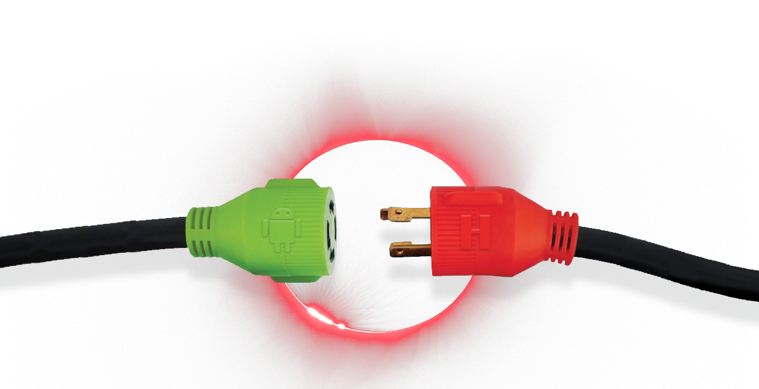
Technology partnerships strengthen offering for customers
Honeywell Confidential - © 2017 by Honeywell International Inc. All rights reserved.
Notes:
Technology partnerships are a key enabler to strengthen solutions capabilities for our customers. Specifically with Mobility Edge, we engaged two significant technology partners to strengthen our mobility offering to customers.
Honeywell partnered with Qualcomm to co-develop a chipset solution that ensures longer lifecycle and enterprise support for our customers. This partnership gives Honeywell unique abilities to launch mobile solutions faster to market and with access to tools that facilitate rapid issue resolution. Our partnership with Qualcomm ensures the optimal extended lifecycle experience for our customers.
With the accelerated adoption of the Android O/S in enterprise, a partnership with Google represents one of several steps taken by Honeywell to strengthen our Android-based enterprise offering. Our partnership with Google enables us to more rapidly offer the benefits of the secure and flexible platform to our mutual customers.

Slide 15
Extended product lifecycle through 2023 Lower your total cost of ownership and future proof your investment.
Android Nougat
2017
Android Oreo
Android P
Android Q
Android R

Slide 16
Certify Once. Deploy Many.
time savings
labor savings
cost savings
Honeywell Confidential - © 2017 by Honeywell International Inc. All rights reserved.
Notes:
Remove time, labor and cost from the extensive process of provisioning, certifying and deploying apps compared to consumer device or other enterprise mobility solutions.

Slide 17
How we rethought the core
Leveraging 10+ years of service and support data to create a unified, dynamic platform
Optimizing Product Design Based on Actual User Patterns
More realistic testing and precise engineering requirements
Preemptively Avoiding Service Disruptions
Applying historical insights from service data to address top failures during the design phase
Improving Product Quality through Mining Support Data
Integrated, built-in usage of support data findings to influence product development and automated testing tools ensure various components work as intended
ACCELERATE
DeploymentS
Mobility Edge™
OPTIMIZE
Performance
EXTEND Lifecycle
Notes:
We took a deep dive into data to create a more robust platform that’s up to your challenges.
Better product design thanks to knowledge of real usage
Avoid service disruptions
Higher product reliability through more realistic product testing
Pre-emptive knowledge of potential problems
More efficient investigation and troubleshooting
Avoid downtime and other costs through automatic and predictive actions
Reduce the mean time to repair of service team
Speed up root cause analysis for faster recovery

Slide 18
A proven framework to build-in security protection
17
17
INDUSTRIAL CYBERSECURITY EXPERTS
PROVEN EXPERIENCE
INVESTMENT AND INNOVATION
Security built-in design to delivery process to anticipate and mitigate risk
Experts in industrial controls, operations and cyber security
Full lifecycle capabilities: assessments, design, deployment, integration, training and support
Global/Regional Industrial cyber service hubs - close to our customers
Pioneer in industrial cyber security. 1,000+ global engagements since 2006
Mature solutions … provider of managed security services for 350+ industrial sites
Tailored solutions to efficiently secure industrial control systems without impacting process
Largest R&D investment in industrial cyber security
Global, state of art Industrial Cyber Security Solutions Labs
Security Operation Centers
Strategic partnerships with leading cyber security product vendors
Industry’s first Cyber Security Risk Manager
Honeywell Confidential - © 2017 by Honeywell International Inc. All rights reserved.
Notes:
Honeywell is a pioneer in industrial cyber-security.
Our security built-in design to delivery process has a strong emphasis on building security into products to anticipate and mitigate risk. We do this through embedding deep domain knowledge of industry-leading security practices throughout our full design and development process to ensure our solutions are as secure as possible from the start. We do this by making our solutions as free of vulnerabilities to attack as possible through such measures as continuous testing, authentication safeguards, and adherence to best programming practices.

Slide 19
Giving you the edge, every step of the way Honeywell Enterprise Mobility ensures an effective, seamless mobile experience
Support for every stage in your mobility solution
Device Deployment
Initial device preparation, configuration, staging and kitting, including DEP/MDM configuration.
Helpdesk Support
Customer-branded, 24x7x365, direct to end-user support on demand.
Device Depot
Spare pool management, device replacement, asset recovery & warranty management.
Lifecycle Management
Out of warranty repair, device protection plans, device buyback services and recycling.
Procurement
Centralized procurement of wireless products and services.
Expense Management
Invoice processing, auditing and optimization of wireless and wireline expenses.
Mobile Software as a Service
Day-to-day administration of leading mobile software products.
Consulting Services
Expert guidance on mobile strategy and IT evaluation.
Resale Services
Sale of accessories, refurbished devices and third party software.
*Honeywell Enterprise Mobility offering varies by region.

Slide 20
A robust service offering to ensure business continuity Choose the offering that best suits your business needs and budget
19
Complete
Device replacement
Software maintenance for browser
Battery replacement
Printhead replacement
Cutter/platen roller replacement
Coverage for docks/chargers
2 business day turn option*
Advanced exchange option
5 year renewals*
Basic device health
Accidental damage coverage
Wear and tear
Cleaning/preventative maintenance
Online technical support
24x5 telephone support
Lifecycle Service Support
Material defects
Plus
Device replacement – for active rugged or stationary products
Accidental damage coverage
Wear and tear
Cleaning/preventative maintenance
24x5 telephone support
Lifecycle Service Support
Up to 5 business day turn
3 year upfront
Up to 2 year renewals
Material defects
Online technical support
Software updates for 90 days
Warranty/Basic
Material defects
Online technical support
Software updates for 90 days
1-2 year upfront
1 year renewals
10-15 business day turn
COVERAGE »
Non-warranty/ Non-contract
10-15 business day
Flat Rate/T&M per incident paid repair
VALUE »

Slide 21
Getting started with Mobility Edge Take the next step on your journey to bring simplicity to your mobile deployments.
Arrange for a personalized, no-cost consultation with a Honeywell expert
Identify the challenges where the Honeywell Mobility Edge platform drives clear value
A dedicated Honeywell team of 25,000 + industrial experts, data scientists and software engineers to solve your needs

